Slide 1
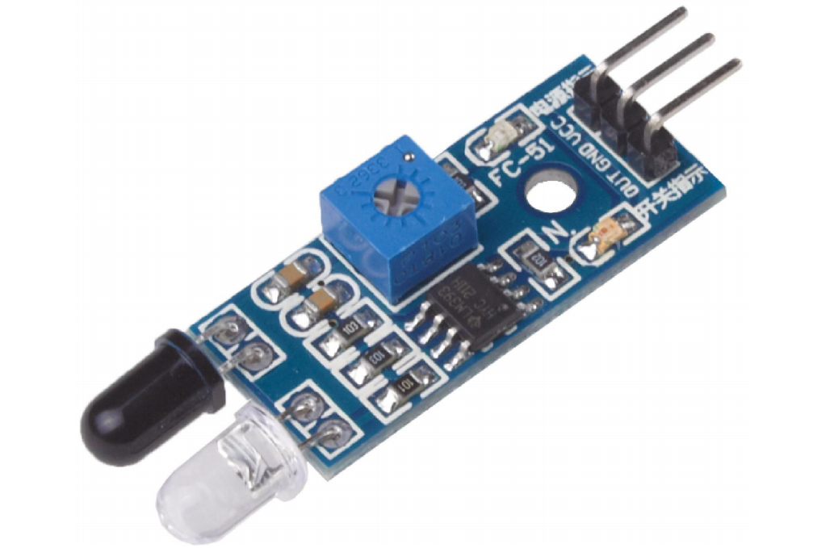
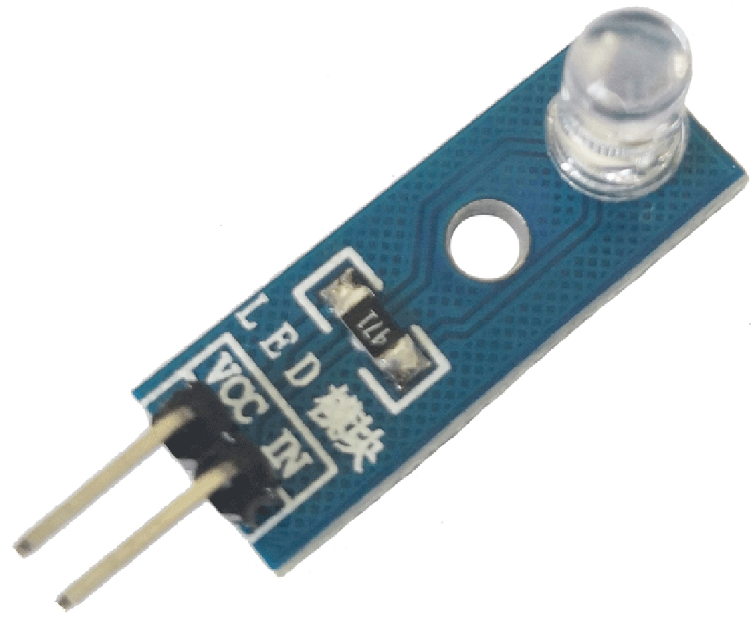
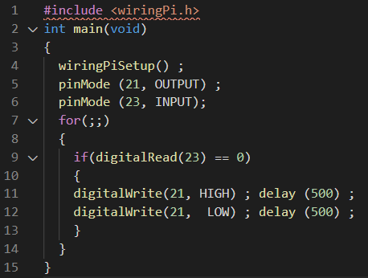
VCC to Board 2
wP | Name | Board | Board | Name | wP
 |  |  | 2 | 5V
 |  |  | 4 | 5v
 |  |  | 6 | GND
 | GND | 9
21 | GPIO.21 | 29 | 30 | GND
23 | GPIO.23 | 33
GND to GND
OUT to wP 23
Infrared Sensor MH-B
Code:
VCC to wP 21
GND to Board 30
Led Module

